Slide 1
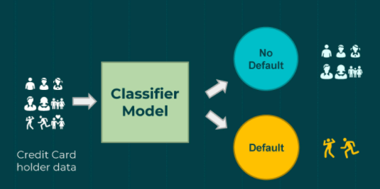
Credit Card Default Prediction
Bhargava Gaggainpali
DSC680 - Applied Data Science
bgaggainpali/bgaggainpali_DSC680 · GitHub

Slide 2
Business problem & Hypothesis
In financial industry, banks are playing important role in challenging times like now, with COVID pandemic across the globe. People are losing jobs and financial institutions are facing more delinquency rate on credit card loans. The increase in delinquency rate will result in significant financial loss to commercial banks. It is very critical for lending institutions like banks to have a prediction model to be able to predict customers for credit card default.
I have selected the topic, as I was interested in knowing the variables which influence the credit card default key factors. As I explore more about the domain, I understand that it’s not same set of rules which is being used across domain and each different banks and credit unions are based on different credit score calculations structure when approving credit cards, but the factors which influence the default are same.

Slide 3
Solution Method
I see this problem as a classification issue, where we should try to understand and able to predict the customers, who have high Credit Card default chances.
Planning to use supervised machine learning algorithm to work on the classification problem to be trained with algorithms like:
1. Logistic Regression
2. Decision Tree
3. Random Forest
Start with loading data into a data frame and then understand the data, then perform Exploratory Data Analysis (EDA) on the data set. EDA involves doing Univariate and Bivariate Analysis, identify missing values and outliers and fill the gaps with appropriate values. In the next step, building model with starting from logistic regression and observe the accuracy of the model. When the accuracy of the of the model is not high, then planning to use Decision Tree and Random Forest to achieve higher accuracy.

Slide 4
Data
Data is sourced from Kaggle, which has all the required variables for prediction.
https://www.kaggle.com/ainslie/credit-card-default-prediction-analysis
Variable Description
ID Credit Card ID - Sequence Number
LIMIT_BAL Credit Limit
SEX 1 = male, 2 = female
EDUCATION 1 = graduate school, 2 = university, 3 = high school
MARRIAGE 1 = married, 2 = single, 3 = others
AGE Customer Age
PAY_0 Repayment status September 2005
PAY_2 Repayment status August 2005
PAY_3 Repayment status July 2005
PAY_4 Repayment status June 2005
PAY_5 Repayment status May 2005
PAY_6 Repayment status April 2005
BILL_AMT1 Bill Amount September 2005
BILL_AMT2 Bill Amount August 2005
BILL_AMT3 Bill Amount July 2005
BILL_AMT4 Bill Amount June 2005
BILL_AMT5 Bill Amount May 2005
BILL_AMT6 Bill Amount April 2005
PAY_AMT1 Payment Amount September 2005
PAY_AMT2 Payment Amount August 2005
PAY_AMT3 Payment Amount July 2005
PAY_AMT4 Payment Amount June 2005
PAY_AMT5 Payment Amount May 2005
PAY_AMT6 Payment Amount April 2005
default.payment.next.month 1 = default, 0 = On time payment

Slide 5
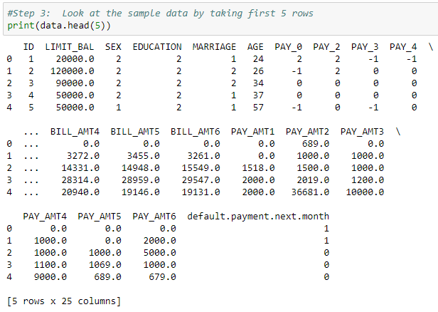
Exploring Data 1
Read first few lines of the data to observe the data variables.

Slide 6
Exploring Data 2
Categorical Features: Based on the data, below are categorical variables.
SEX
EDUCATION
MARRIAGE
default.payment.next.month 1 = default, 0 = On time payment
Ordinal Features: Based on the data with inherent hierarchy, below are ordinal variables.
AGE
PAY_0, PAY_2, PAY_3, PAY_4, PAY_5 & PAY_6
Numerical Features: Based on the numerical data, below are numerical variables.
BILL_AMT1, BILL_AMT2, BILL_AMT3, BILL_AMT4, BILL_AMT5 & BILL_AMT6
PAY_AMT1, PAY_AMT2, PAY_AMT3, PAY_AMT4, PAY_AMT5 & PAY_AMT6

Slide 7
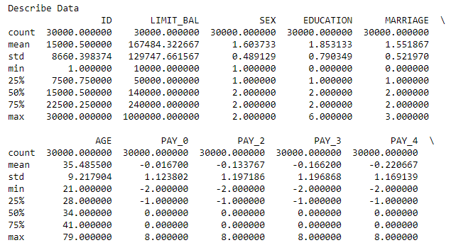
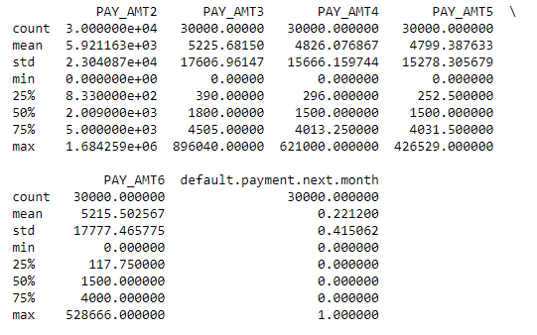
Exploring Data 3
Retrieve the stats of the data to observe the count, min, max, mean and standard deviation including the target variable.

Slide 8
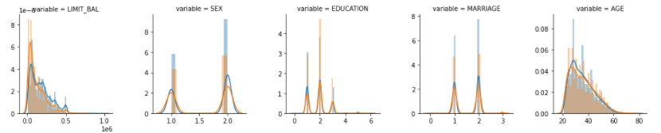
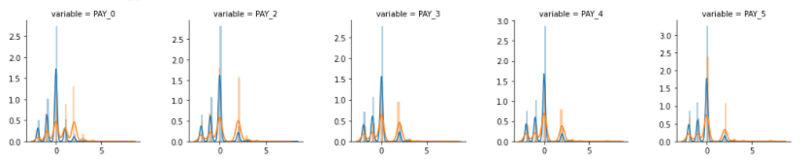

Plots 1

Slide 9
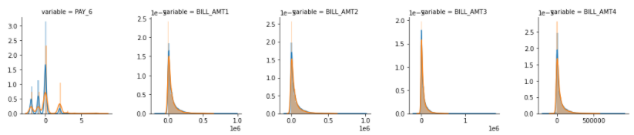
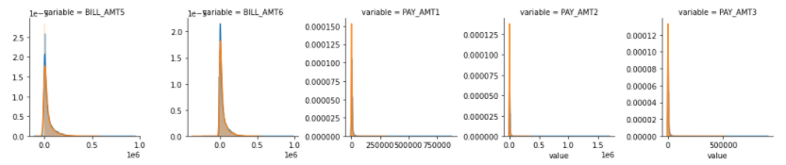
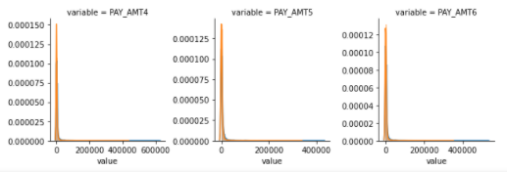
Plots 2

Slide 10
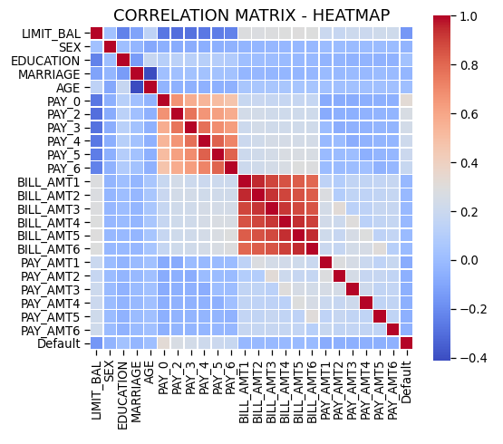
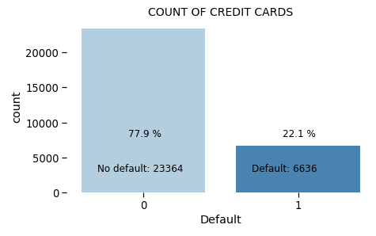
Plots 3
Built Correlation Heatmap and target variable Bar Plot.

Slide 11
Observations
Customers with low LIMIT_BAL have higher Default rate.
Default rate low among Females(Sex=2)
Customers with highly educated are less like to default (EDUCATION=1 or 2)
Customers with Marital status single are less like to default (MARRIAGE=2)
People in the age group 30-40 years are less likely to default

Slide 12
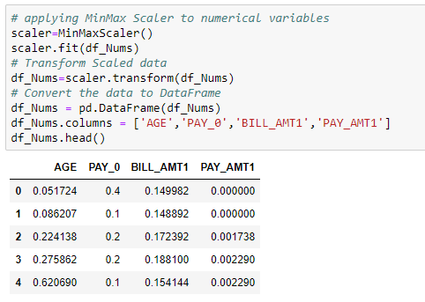
Scaling the Numeric Data
Applied MinMax Scaler to scale the numeric data variables.

Slide 13
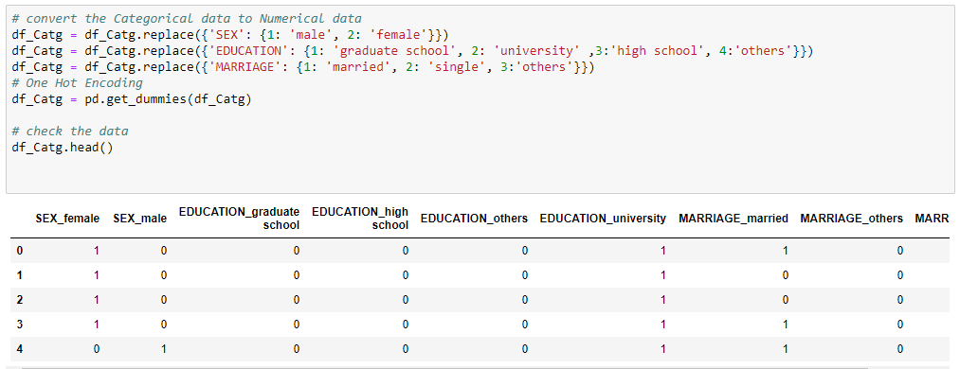
Categorical Data to Numeric
Applied One Hot Encoding to convert Categorical data to Numerical data variables.

Slide 14
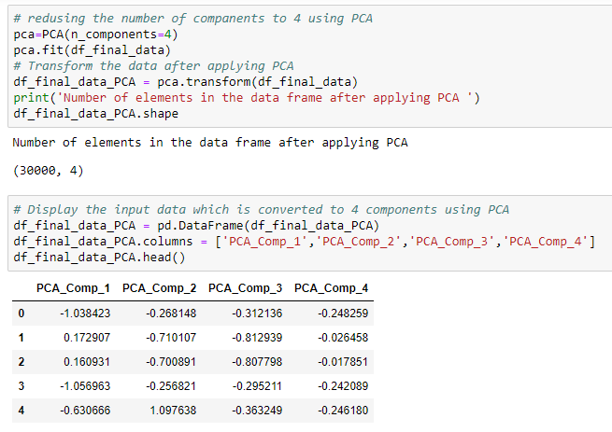
Dimensionality Reduction
Applied PCA to reduce the number of Dimensions or Variables.

Slide 15
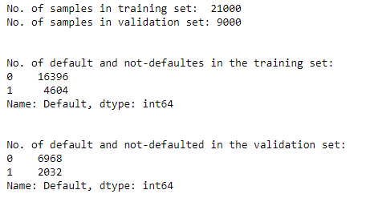
Separate Train and Test Data
Split the available data in the ratio of 70:30 for training and testing the model. Also making sure to have both Default and Not Default data in both training and testing data sets.

Slide 16
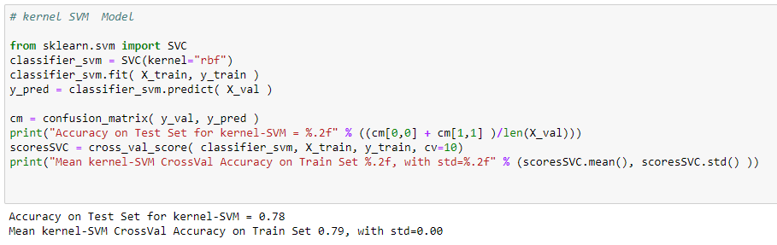
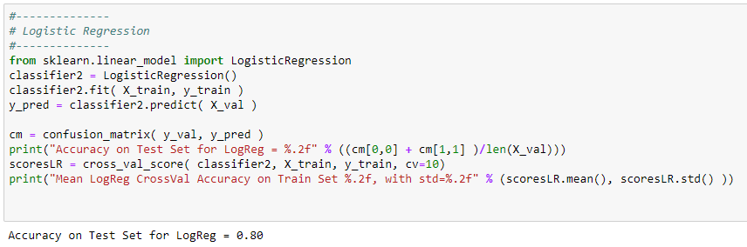
Predictive Models
Predictive models build are built using ‘SVM’ & ‘Logistic Regression’.

Slide 17
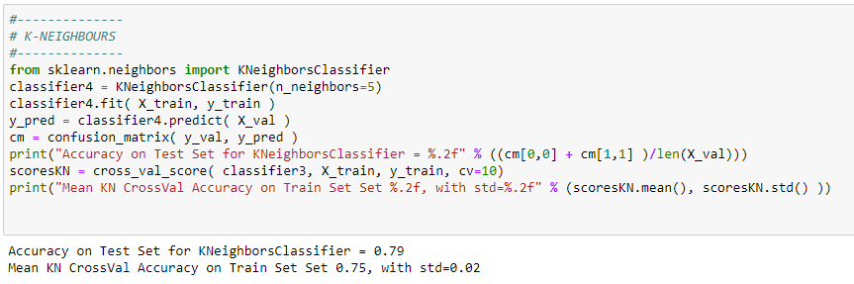
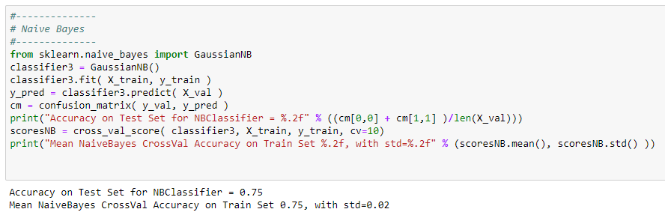
Predictive Models
Predictive models build are built using ‘KNeighborsClassifier’ & ‘Naïve Bayes’.

Slide 18
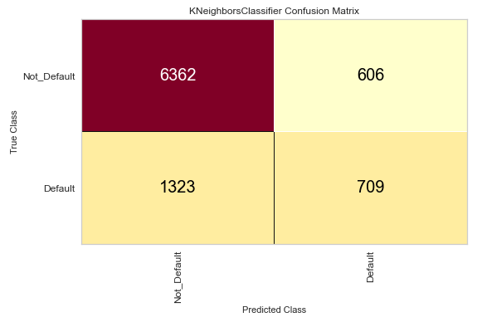
Confusion Matrix
Chart shows the good Value in the ‘True Positive’ and ‘False Negative’ compared to ‘False Positive’ and ‘True Negative’ indicates that model is performing as expected.

Slide 19
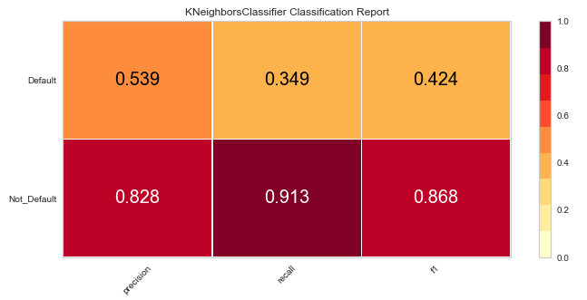
Classification Report
Chart shows the good precision and recall values and f1score 0.868 for not-Default cases indicates that model is performing as expected.

Slide 20
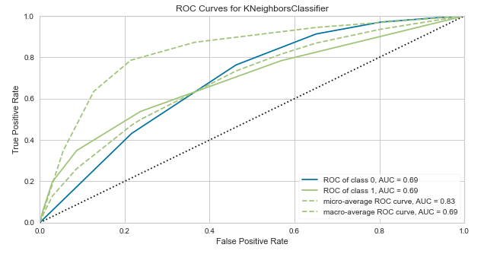
ROC Curve
Chart shows the AUC (Area Under Curve) is at a value of 0.69 indicates that model is performing as expected.

Slide 21
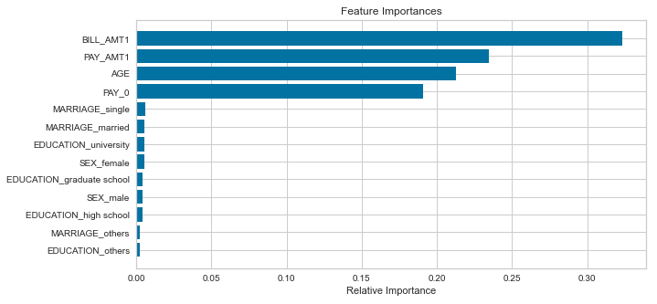
Feature Importance
Given chart shows that Bill Amount is most important factor in deciding the Credit Card default followed by Payment Amount and Age.

Slide 22
Future Analysis Questions
I would like to continue my analysis and try to explore further to find answers to the given questions.
With the COVID situation in place, are these features still valid to predict the Credit Card Default.
As with the different type of defaults like Credit Card, Car Loan, Home Loan, would these features stay in common across industry.
Will the feature importance change with respect to geographic location?

Slide 23
Reference
1. LATOYA IRBY - February 10, 2020 - What You Can Do About Credit Card Default
What You Can Do About Credit Card Default (thebalance.com)
2. Jenny Wang - Jun 24, 2020 - Will You Be Able to Make Your Credit Card Payment?
Will You Be Able to Make Your Credit Card Payment? | by Jenny Wang | Towards Data Science
3. Marcos Dominguez - Feb 26,2021- Predicting Credit Card Defaults with Machine Learning
Predicting Credit Card Defaults with Machine Learning | by Marcos Dominguez | The Startup | Feb, 2021 | Medium
4. Yashna Sayjadah, Ibrahim Abaker Targio Hashem, Faiz Alotaibi, Khairl Azhar Kasmiran - October 2018 - Credit Card Default Prediction using Machine Learning Techniques
(PDF) Credit Card Default Prediction using Machine Learning Techniques (researchgate.net)
5. Bank Rate – 2021 - Credit card default: How it happens, what to do about it
Credit Card Default: What to Do About It | Bankrate.com
6. Equifax – 2021 - What Happens If I Default on a Loan or Credit Card Debt?
Process & Potential Effects of Defaulting on a Loan | Equifax

